Slide 1

Note: The data and information in this document is reflective of a hypothetical situation and client. This document is to be used for KPMG Virtual Internship purposes only.
Sprocket Central Pty Ltd
Data analytics approach
[Division Name] - [Engagement Manager], [Senior Consultant], [Junior Consultant]

Slide 2
Note: The data and information in this document is reflective of a hypothetical situation and client. This document is to be used for KPMG Virtual Internship purposes only.
Agenda
Introduction
Data Exploration
Model Development

Slide 3
Note: The data and information in this document is reflective of a hypothetical situation and client. This document is to be used for KPMG Virtual Internship purposes only.
Introduction and Objective
Sprocket Central Pty Ltd specializes in high-quality bikes and accessible cycling accessories to riders. Their marketing team is looking to boost business by analyzing their existing customer dataset to determine customer trends and behaviour .
Sprocket Central Pty Ltd has given 3 datasets : Customer Address, Customer Demographics,
Transaction Details.
Using the dataset as labelled data set we try to analyse customer behaviour and draw insights to recommend which customers from our New Customer List should be targeted.

Slide 4
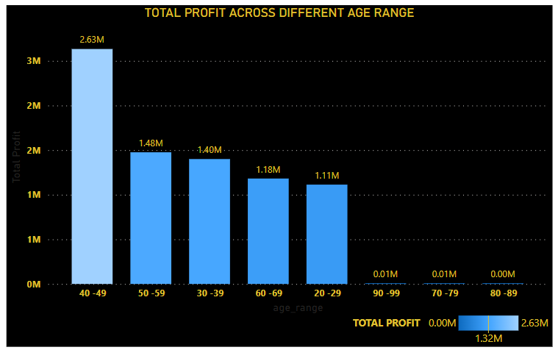
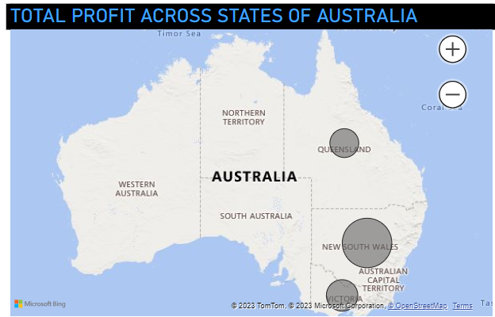
Note: The data and information in this document is reflective of a hypothetical situation and client. This document is to be used for KPMG Virtual Internship purposes only.
Data Exploration
Most of the profit comes from people withing age range 40-49.
Most of the profit comes from the people in the state New South Wales

Slide 5
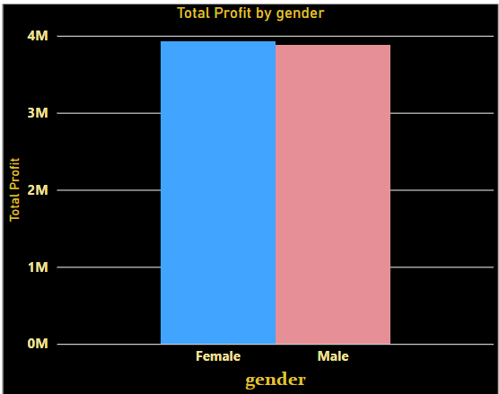
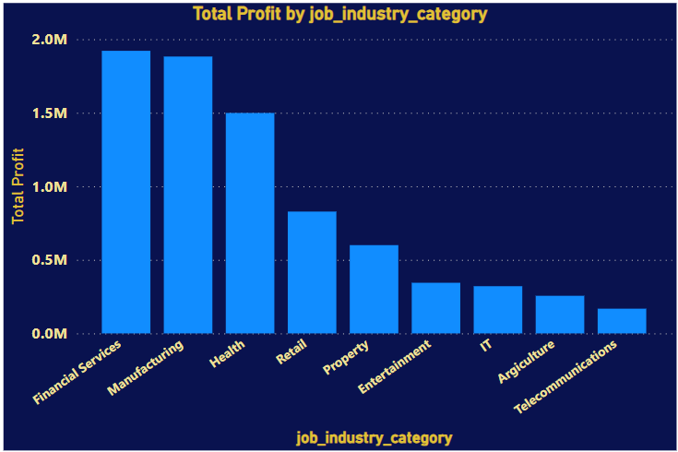
Note: The data and information in this document is reflective of a hypothetical situation and client. This document is to be used for KPMG Virtual Internship purposes only.
Data Exploration
Profit contributed by male customers and female customers are almost similar
Most of the profit is contributed by customers working in Financial services followed by Manufacturing industry

Slide 6
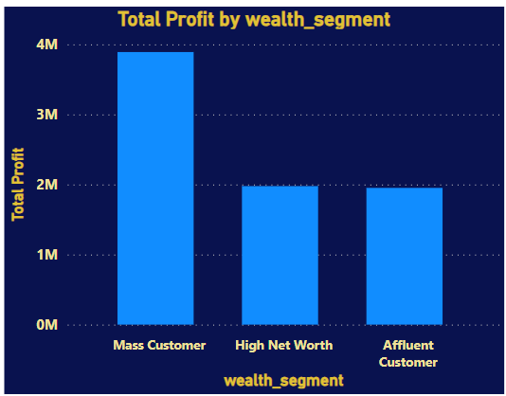
Note: The data and information in this document is reflective of a hypothetical situation and client. This document is to be used for KPMG Virtual Internship purposes only.
Data Exploration
Most profit contribution by customers who belong to the wealth segment Mass Customers. Customers having high networth and affluent customers have almost equal contribution to the profit of the company.

Slide 7
Note: The data and information in this document is reflective of a hypothetical situation and client. This document is to be used for KPMG Virtual Internship purposes only.
Model Development
Customers with following attribute should be targeted
Customers in age range 40-49
Customers working in Financial Servicesband Manufacturing industry should be targeted
Customers living in New South Wales , Australia are high value clients

Slide 8
Note: The data and information in this document is reflective of a hypothetical situation and client. This document is to be used for KPMG Virtual Internship purposes only.
Thank You

